Slide 1

IPC THROUGH SHARED MEMORY
BY
AKSHAY PAWAR (2021A1R006)
MANUJ KHAJURIA (2021A1R021)
SURESH DUB (2021A1R030)
Guide
Miss. Veena Tripathi
Assistant Professor

Slide 2
WHAT IS INTER-PROCESS COMMUNICATION?
Inter-process communication (IPC) is a mechanism that allows processes to communicate with each other and synchronize their actions.
The communication between these processes can be seen as a method of co-operation between them.
Processes can communicate with each other through Shared Memory

Slide 3
WHAT IS SHARED MEMORY?
Shared memory is a memory shared between two or more processes.
Shared memory is an efficient means of passing data between programs.
One program will create a memory portion which other processes (if permitted) can access.

Slide 4
WHY DO WE NEED TO SHARE MEMORY?
Each process has its own address space.
If any process wants to communicate some information from its own address space to other processes, then it is only possible with IPC techniques
Inter-related process communication is performed using pipes.
Unrelated processes communication can be performed using Named pipes or through popular IPC techniques of Shared Memory and Message Queues.

Slide 5
HOW DIFFERENT IS SHARED MEMORY FROM OTHER IPC’S ?
The problem with pipes , FIFO , Message Queue . The information has to go through Kernel.
A total of four copies of data are required.
Shared Memory provides a way by letting two or more processes share a memory segment.
With Shared Memory the data is only copied twice
From input file into shared memory and from shared memory to the output file.

Slide 6
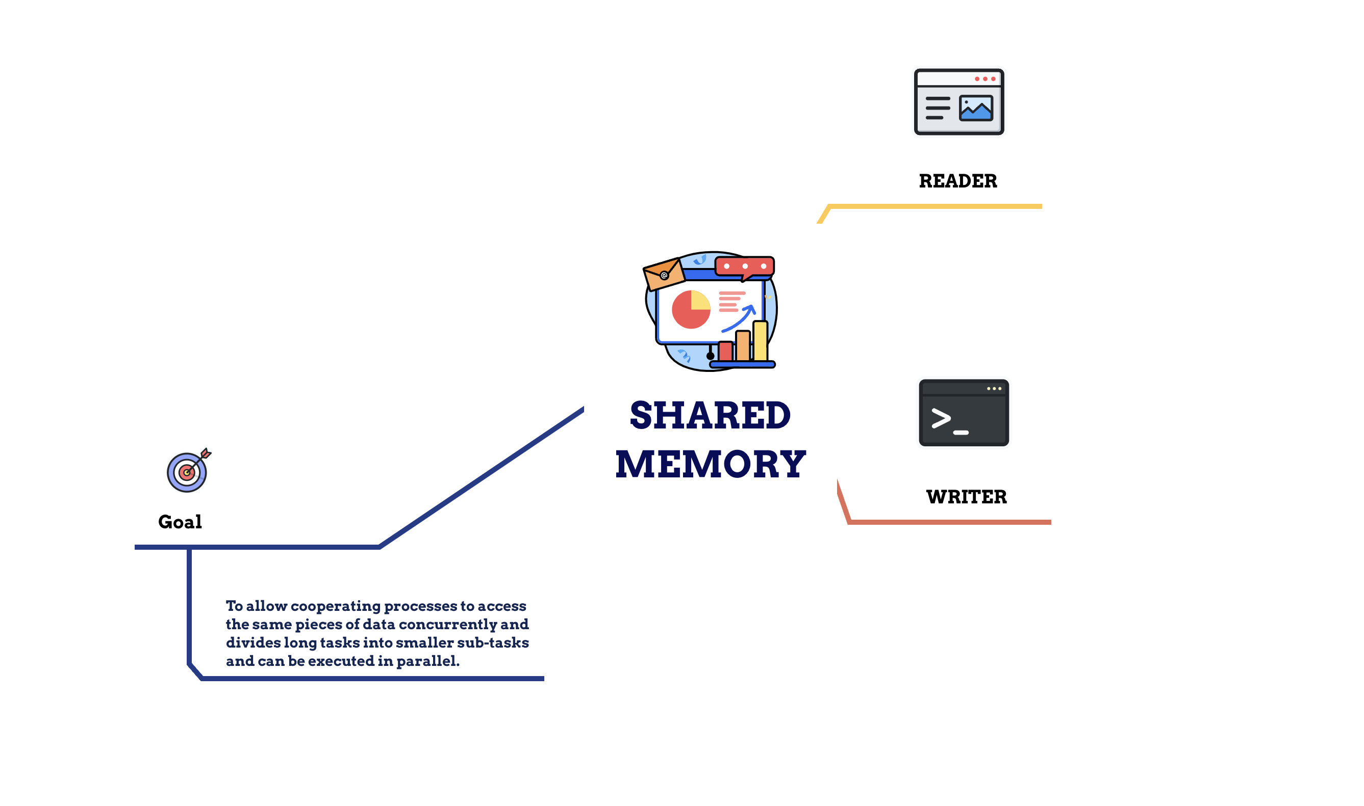

Slide 7
SYSTEM CALLS USED ARE :
shmget() : is used to obtain access to a shared memory segment.
shmat() : is used to attach shared memory segments.
shmdt() : is used to detach shared memory segments.
shmctl() : is used to alter the permissions and other characteristics of a shared memory segment.

Slide 8
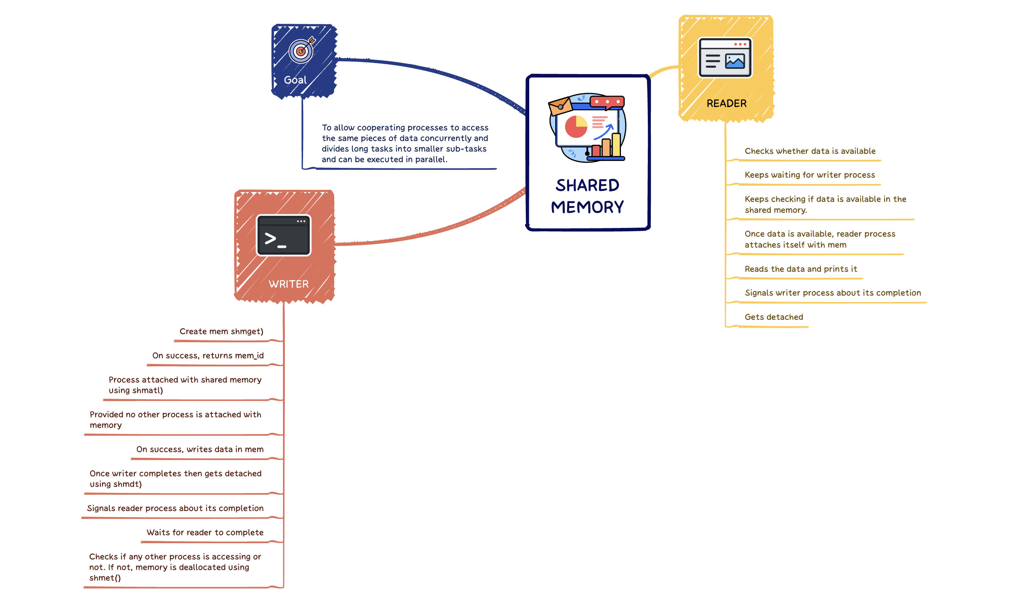

Slide 9
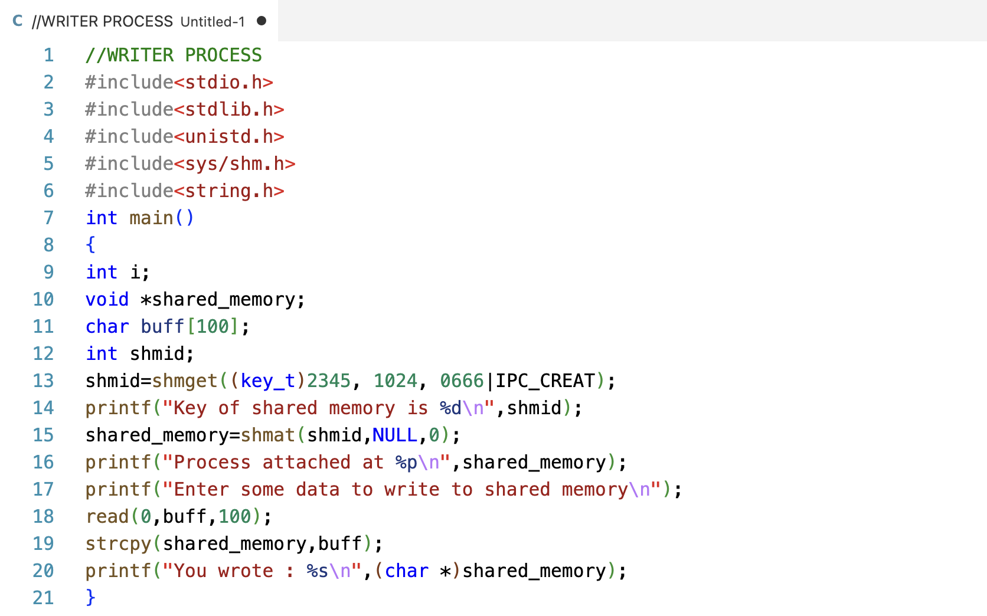

Slide 10
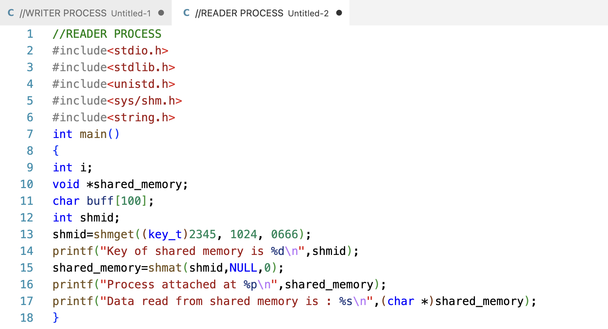

Slide 11
ADVANTAGES OF SHARED MEMORY
Faster method than queues.
Does not require extra kernel buffer.
Safe , manipulated like other variables.

Slide 12
DISADVANTAGES OF SHARED MEMORY
Data can either read or written only .
Append is not possible.
Race condition is possible so locking is required .

Slide 13


GITHUB
https://github.com/Suresh-Dub/OPERATING-SYSTEM-PROJECT

Slide 14
THANK YOU

